Slide 1







Prediction Page UI
Turning ML into Actionable Interfaces with Streamlit

Slide 2







a
Overview
Points:
Modular Streamlit design
User-friendly layout with st.metric()
Input validation and logging
Real-world deployment scenario

Slide 3


Learning Outcomes Overview
Core Concepts
User Experience
Implementation Skills
Practical Application
Build modular Streamlit prediction UIs
Display model outputs using st.metric()
Add robust input validation logic
Log predictions for monitoring and fairness
Apply best practices from UI to model integration

Slide 4



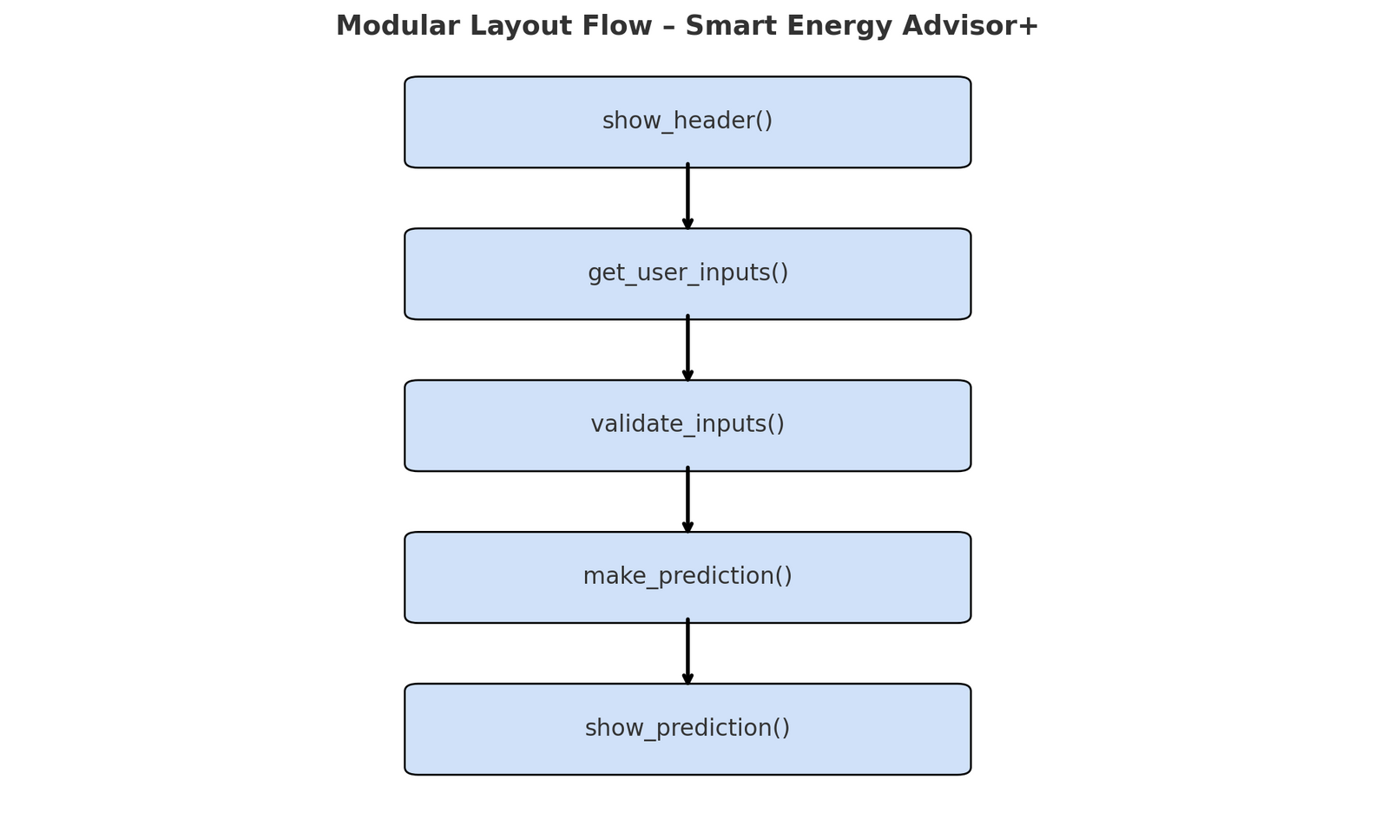
Modular Layout Concept
Feature | Description
show_header() | Displays UI title and description.
get_user_inputs() | Captures form input from the user.
validate_inputs() | Filters and checks for invalid entries.
make_prediction() | Loads the model and performs prediction.
show_prediction() | Displays the output in a user-friendly format.

Slide 5




Using st.metric() for Effective Output
Visual feedback using:
Columns layout for side-by-side metrics:
User-Friendly Interface
Display important metrics using dynamic visual elements.
Enhance user experience with intuitive design choices.
Organize outputs into clear, visual sections for user clarity.
st.metric("Predicted Load (kW)",
"2.95", "+0.12 vs baseline")

Slide 6

Input Validation Benefits
Accuracy
Security
User Experience
Efficiency
Ensures user input meets all required formats.
Protects against malicious inputs and vulnerabilities.
Improves trust
Reduces processing time by filtering invalid data early.
Flags anomalies
Enhances user satisfaction with clear feedback on errors.
Prevents crashes
Check user inputs with:

Slide 7
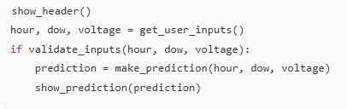
Complete Prediction Page
Code Structure
User Input
Output Display
Logging
Clear functions and modular design for easy understanding
Efficient handling of user data with validation checks
Utilizing st.metric() for effective result representation
Tracking predictions and user interactions for improvements

Slide 8

Logging Predictions
Code
Use Cases
Benefits
Tools
Implementing logging in machine learning applications
Practical scenarios for utilizing logging effectively
Improving model performance through better insights
Software and libraries to facilitate logging predictions

Slide 9
Real-World Case Study
Outcomes
Tools
Methodology
Impact
Enhanced predictive accuracy, improved decision-making, user satisfaction, cost reduction
Python libraries, Streamlit framework, machine learning algorithms, data visualization tools
Data collection strategies, model training, validation techniques, deployment processes
Increased efficiency, better resource allocation, community engagement, environmental sustainability

Slide 10




Features and Descriptions Summary
Feature | Description
st.metric() | Displays model output
validate_inputs() | Checks data validity
joblib.load() | Loads trained model
Modular layout | Improves clarity & reuse
Logging | Enables audits, fairness analysis

Slide 11
Quiz Time!
Quiz Qs:
What function is used to load model.pkl?
Why modularize the script?
How to block 300V input?
What allows side-by-side metrics?

Slide 12




Thank You For Listening

